Slide 1
Multiplexers
Abu Humayed Azim Fahmid
Lecturer, CSE Dept., UIU

Slide 2
Multiplexers
A multiplexer is a combinational circuit that selects one of many input lines (2^{n}) and directs it to its single output line.
There are n selection lines whose bit combinations determine which input is selected.

Slide 3
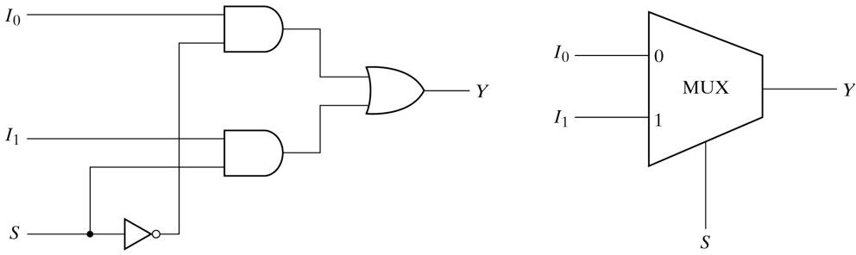
2:1 MUX

Slide 4
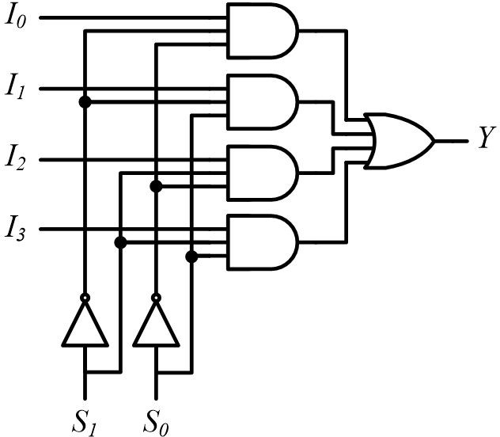
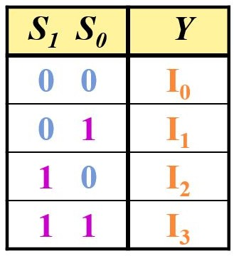
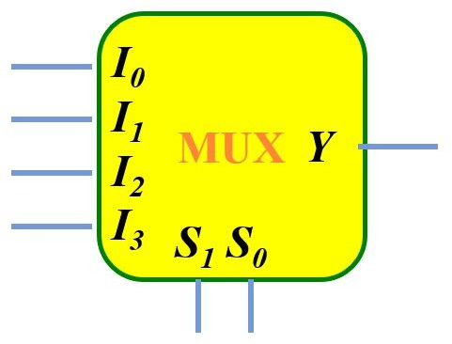
4:1 MUX

Slide 5
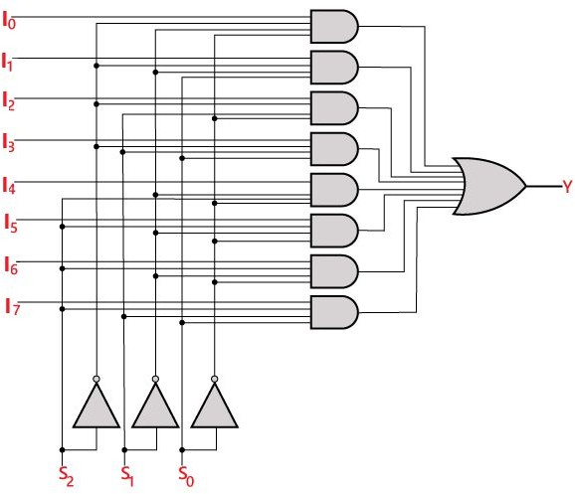
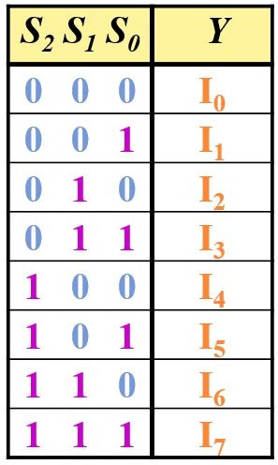
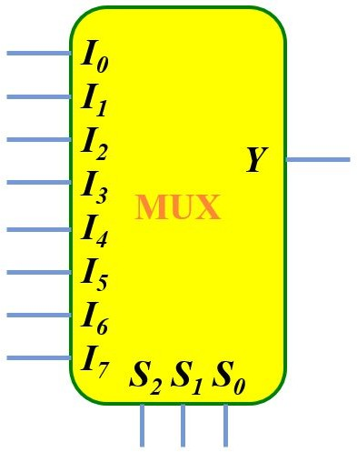
8:1 MUX

Slide 6
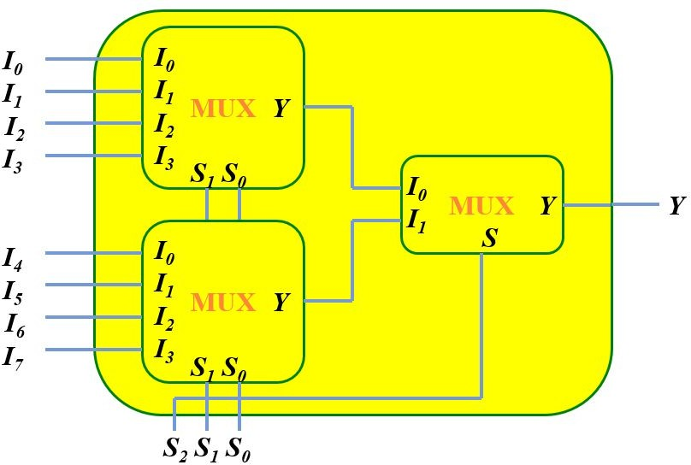
Multiplexer Expansion
Making 8:1 MUX using two 4:1 MUX and 1 2:1 MUX

Slide 7
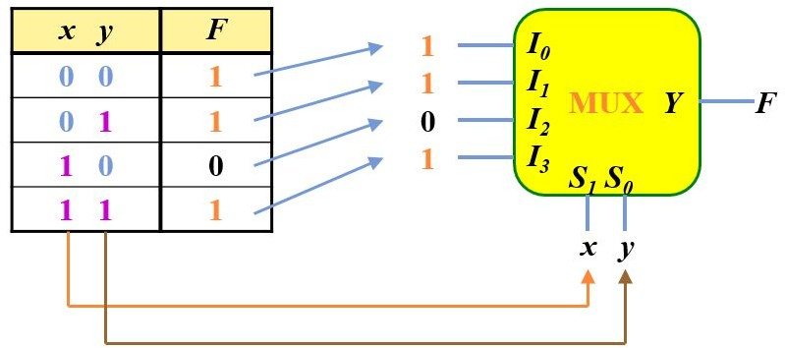
Function Implementation Using Multiplexers
Example: F(x, y) = ∑m(0, 1, 3)

Slide 8
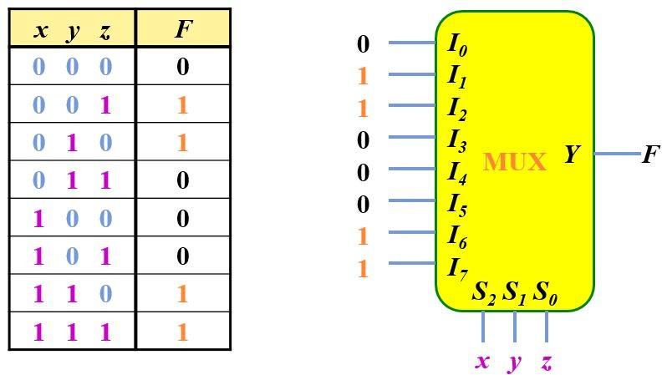
Function Implementation Using Multiplexers
Example: F(x, y, z) = ∑m(1, 2, 6, 7)

Slide 9

Function Implementation Using Multiplexers
Example: F(x, y, z) = ∑m(1, 2, 6, 7)
But what if you are asked to use a 4:1 MUX?

Slide 10
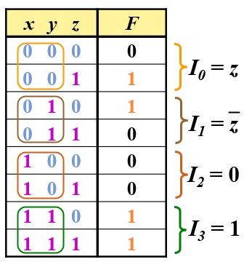
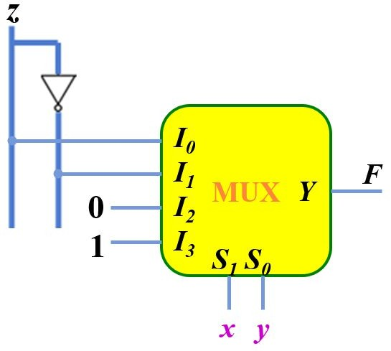
Function Implementation Using Multiplexers
Example: F(x, y, z) = ∑m(1, 2, 6, 7)

Slide 11
Function Implementation Using Multiplexers
Example: Now solve this using 8:1 MUX
F(A, B, C, D) = ∑(1, 3, 4, 11, 12, 13, 14, 15)

Slide 12
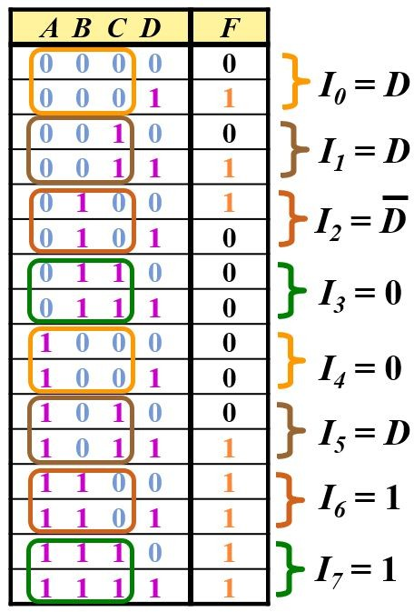
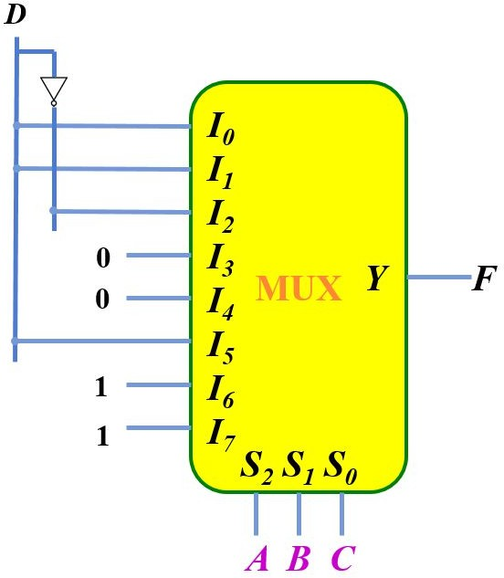
Function Implementation Using Multiplexers
Example: F(A, B, C, D) = ∑(1, 3, 4, 11, 12, 13, 14, 15)

Slide 13
Function Implementation Using Multiplexers
Example: F(A, B, C, D) = ∑(1, 3, 4, 11, 12, 13, 14, 15)
Now, what if you are asked to use a 4:1 MUX?

Slide 14

Function Implementation Using Multiplexers
Example: F(A, B, C, D) = ∑(1, 3, 4, 11, 12, 13, 14, 15)
Now, what if you are asked to use a 4:1 MUX?

Slide 15
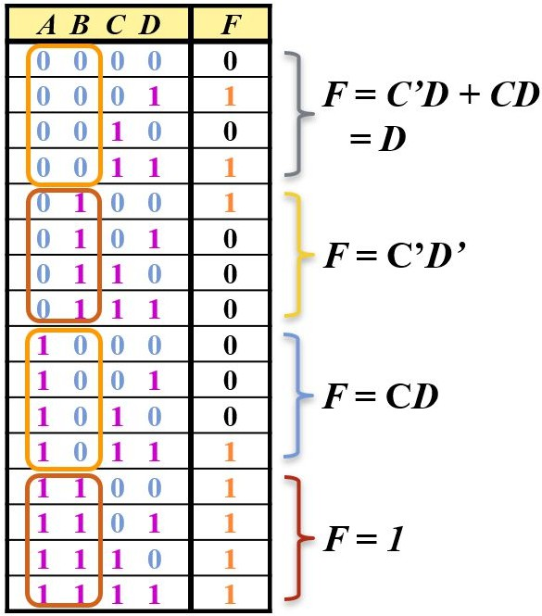
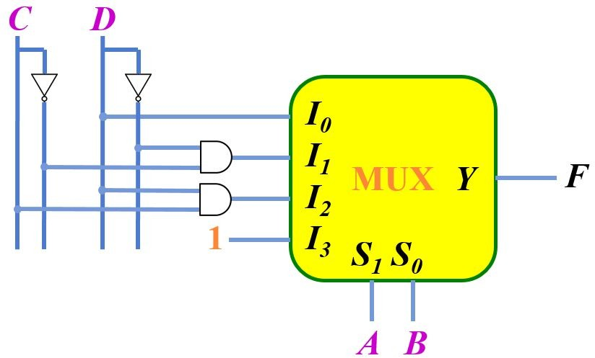




Function Implementation Using Multiplexers
Example: F(A, B, C, D) = ∑(1, 3, 4, 11, 12, 13, 14, 15)

Slide 16

Now let's solve some problems!

Slide 17
Problem

Slide 18
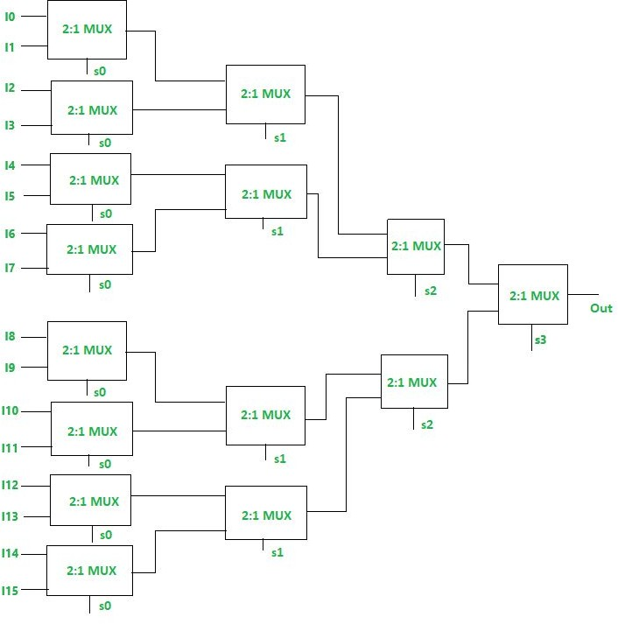
Solution

Slide 19
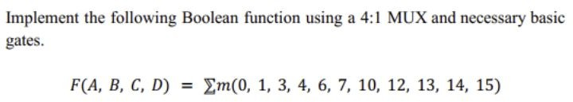
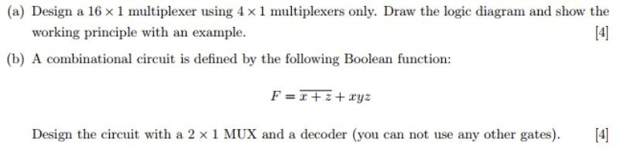
More Problems

Slide 20
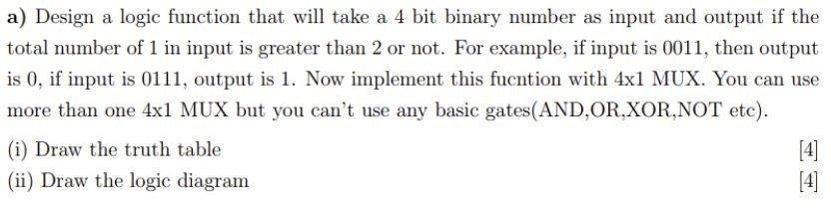
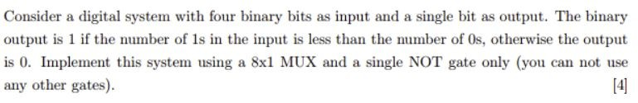
More Problems

Slide 21

Practice more!!
Check book exercises and previous ﬁnal questions

Slide 22


